Slide 2
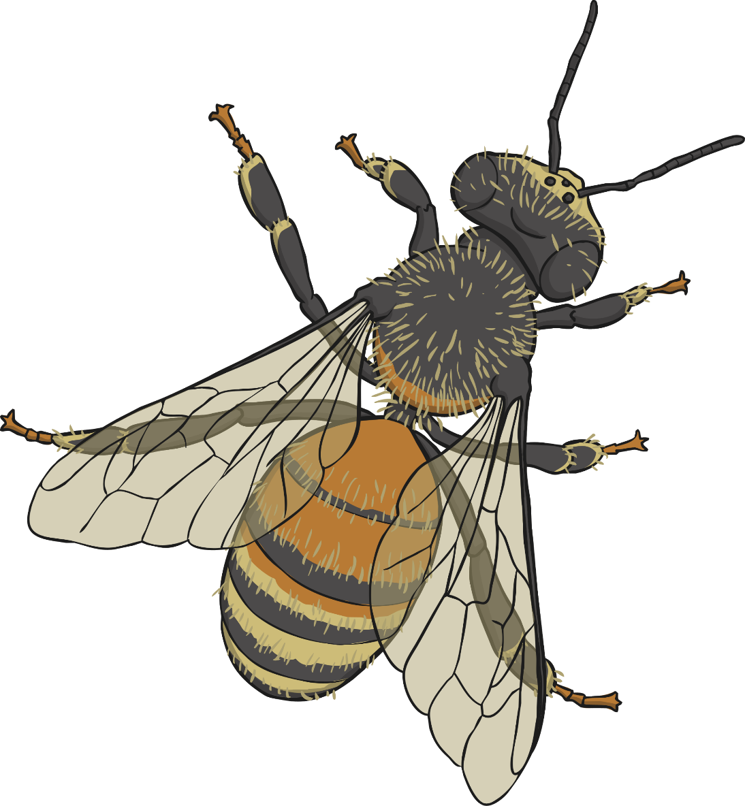
Honeybees
Click the different parts of the honeybee to learn more.
1
2
6
3
4
5
7
Next slide

Slide 3
The Honeybee’s Antennae
1
A honeybee has two antennae which are bent. They are very sensitive and can pick up the flow of air and temperature which helps the honeybee land safely. They can also taste and smell with the antennae.
Watch this video to learn more about a honeybee’s antennae.
Please check the content in this link, including any comments, is suitable for your educational environment before showing. Please do not let the next video automatically play at the end of the clip. Twinkl accepts no responsibility for the content of third party websites.
Back to Honeybee

Slide 4
The Honeybee’s Mandible
The honeybee’s mouth parts are called the mandible.
The honeybee’s mandibles are too small to bite human skin but they can be quite dangerous for other insects that try to invade the hive. They use their mandibles to drink and eat.
2
Back to Honeybee

Slide 5
The Eye Of The Honeybee
3
A honeybee has five eyes. It has two large eyes that are made up of many tiny lenses. We call these large eyes compound eyes. These eyes allow the bee to see movement very well. Honeybees do not see the same colours as we do. They can see ultraviolet light which is impossible for us to see but they can’t see red.
A honeybee has three other eyes called ocelli. They are in a triangle shape on the bee’s head. They can’t see images but they can see light and dark.
Back to Honeybee

Slide 6
The Honeybee’s Body Parts
The honeybee has three different body sections: the head, thorax and abdomen.
head
thorax
abdomen
Back to Honeybee

Slide 7
The Honeybee’s Wings
The honeybee has two pairs of transparent wings that are attached to its thorax. Honeybees flap their wings very fast, it is almost impossible to see the wings flapping while the bee hovers or flies.
5
Watch this video to see a honeybee flying in slow motion
Please check the content in this link, including any comments, is suitable for your educational environment before showing. Please do not let the next video automatically play at the end of the clip. Twinkl accepts no responsibility for the content of third party websites.
Back to Honeybee

Slide 8
The Honeybee’s Legs
Honeybees have 6 legs that are attached to the thorax. The hindlegs have pollen baskets on them that the bees stuff full of pollen to take back to the hive. The baskets are transparent (see-through) so when you look at a bee you can see the yellow and orange pollen inside the baskets.
The honeybee has a special notch on its front legs that it uses to help keep its antennae clean.
6
Watch this video to see a honeybee collecting pollen
Please check the content in this link, including any comments, is suitable for your educational environment before showing. Please do not let the next video automatically play at the end of the clip. Twinkl accepts no responsibility for the content of third party websites.
Back to Honeybee

Slide 9
The Honeybee’s Sting
A honeybee is the only kind of bee with a barbed (hooked) stinger. This means that it can only sting once and the sting stays behind in the creature that they have stung. Unfortunately, when a honeybee stings, part of its abdomen - the venom sack - is left behind connected to the sting. This means that the honeybee dies. This is why honeybees only sting if they feel they are in a lot of danger and to protect the hive.
If you are ever stung, make sure you scrape the sting out and do not squeeze the venom sack connected to the sting.
7
Back to Honeybee

Slide 10
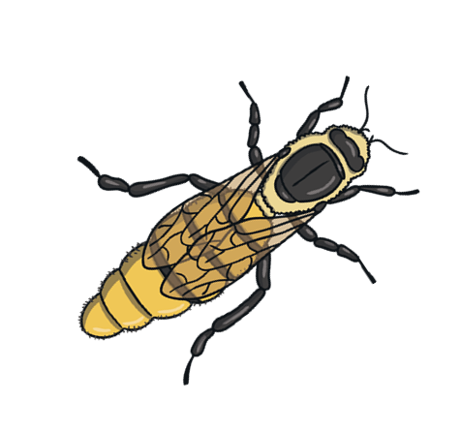
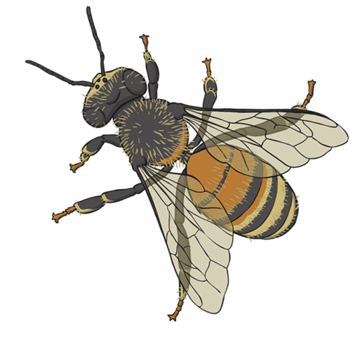
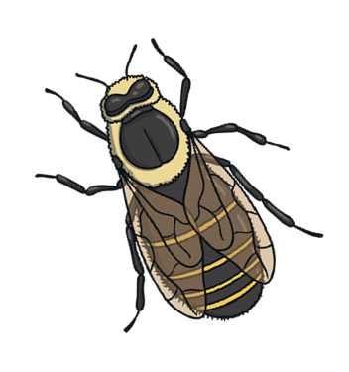
How Do Honeybees Make Honey?
Watch this video to see how a honeybee makes honey
Please check the content in this link, including any comments, is suitable for your educational environment before showing. Please do not let the next video automatically play at the end of the clip. Twinkl accepts no responsibility for the content of third party websites.

